Slide 1
Group 3 – FCEPH
Team Project
Anis Subba - Jennifer Odongo - Benjamin Mapamboli - Nazir Mohammmad
https://github.com/AKLBeast/AKLbeast-

Slide 2

FCEPH | Introduction

Slide 3
FCEPH | Recap

Slide 4
FCEPH | Recap

Slide 5
FCEPH | Anis
Project Manager
Meeting Minute Documentation
Project Planning with the team
Suppliers Interface
User should be able to view stock amount. REMOVED
There should be a list of suppliers with their details.
User should be able to select a supplier.
User should be able to select type of product from supplier.
User should be able to place order with supplier.
Stock should be updated. REMOVED

Slide 6
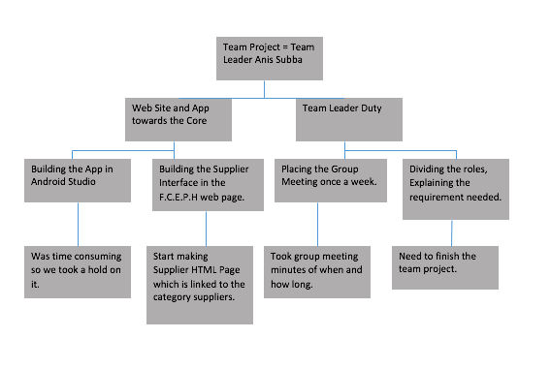
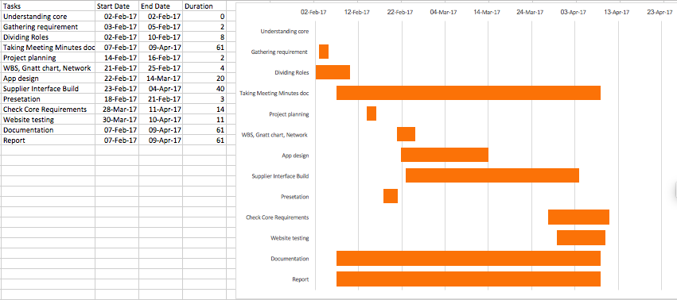
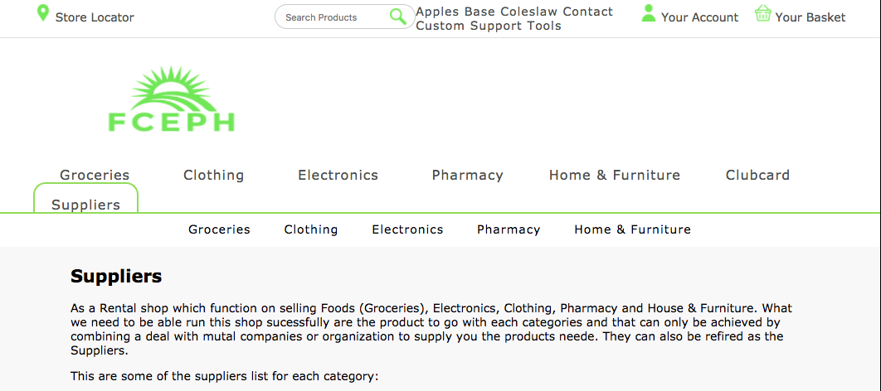
FCEPH | Anis – Project Plan
WBS: It tell you what divides my roles and duties in the whole project.
Gantt Chart showing you how much time it took me to finish certain aspect of the projects.
This is a preview of my Supplier Page.
Risk Registry : Show you some of the Positive Risk and Negative Risk developed in the project.

Slide 7
FCEPH | Jennifer
Documentation
Loyalty Scheme

Slide 8
FCEPH | Jennifer – Project Plan

Slide 9
FCEPH | Nazir
Integration
Payment

Slide 10
FCEPH | Nazir – Project Plan

Slide 11
FCEPH | Benjamin
Quality Assurance
Marketing

Slide 12
FCEPH | Benjamin – Project Plan

Slide 13
Any Questions?

